Slide 1
Insights from Netflix Movies & TV Shows Info

Slide 2
About this dataset
Netflix is one of the most popular media and video streaming platforms. They have over 8000 movies or tv shows available on their platform, as of mid-2021, they have over 200M Subscribers globally. This tabular dataset consists of listings of all the movies and tv shows available on Netflix, along with details such as - cast, directors, ratings, release year, duration, etc.

Slide 3
Objective
To perform basic Exploratory Data Analysis on Netflix data, derive basic insights from it like
What percentage are movies and what percentage are TV shows?
Countries with the highest amount of production?
What are the types of rating system?
The most commonly produced genres?
What is the distribution chart of the seasons of the series?
What is the ideal duration for movies?
What month has the most content added to Netflix?

Slide 4
Approach and Analysis
Data tables downloaded from Kaggle.com
Using Jupyter Notebook and Python Pandas to Transform dataset
Formatted, compiled and cleaned in one single dataset
Statistical inference and graphical visualization will be employed using Tableau

Slide 5
Technical challenges
Deleting redundant columns.
Dropping duplicates.
Cleaning individual columns.
Remove the NaN values from the dataset

Slide 6
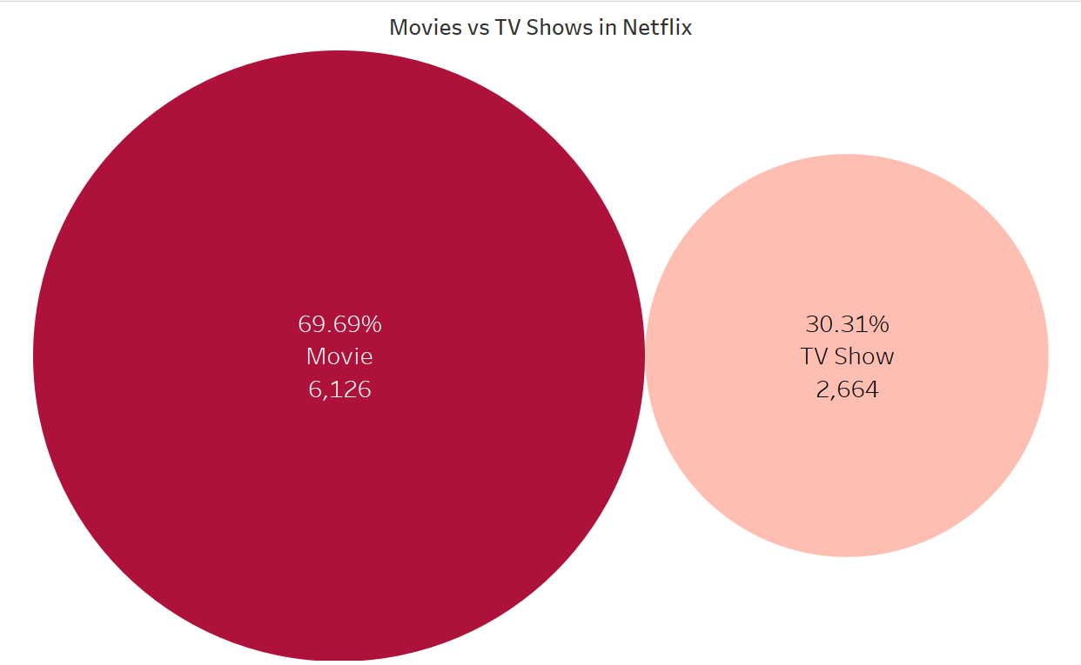
percentage of movies and TV shows
In terms of content percentage, movies are 69.69% and TV shows are 30.31%.

Slide 7
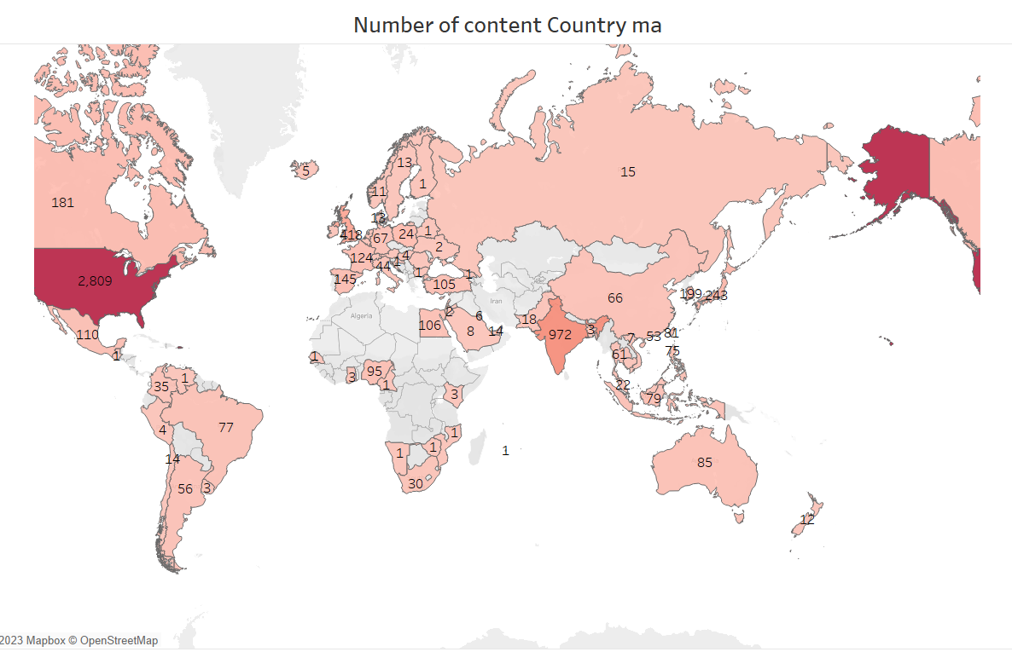
Countries wise Production Distribution

Slide 8
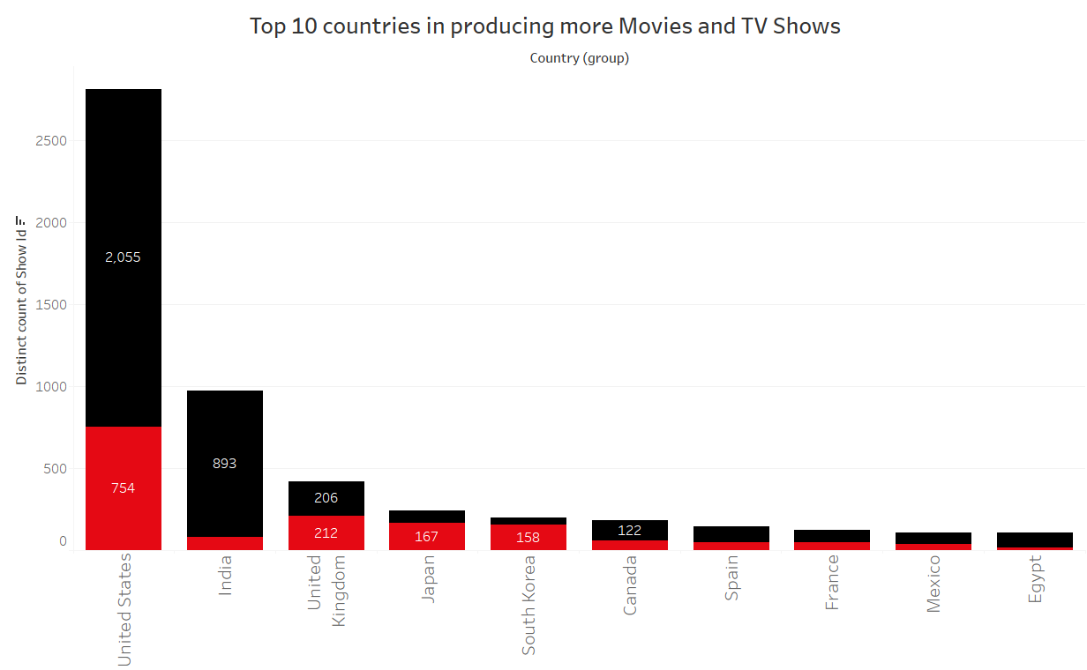
Countries with the Highest Amount of Production
Most number of Movies and TV Shows are produce by United States, followed by india who has produced the second most number of movies on Netflix.

Slide 9
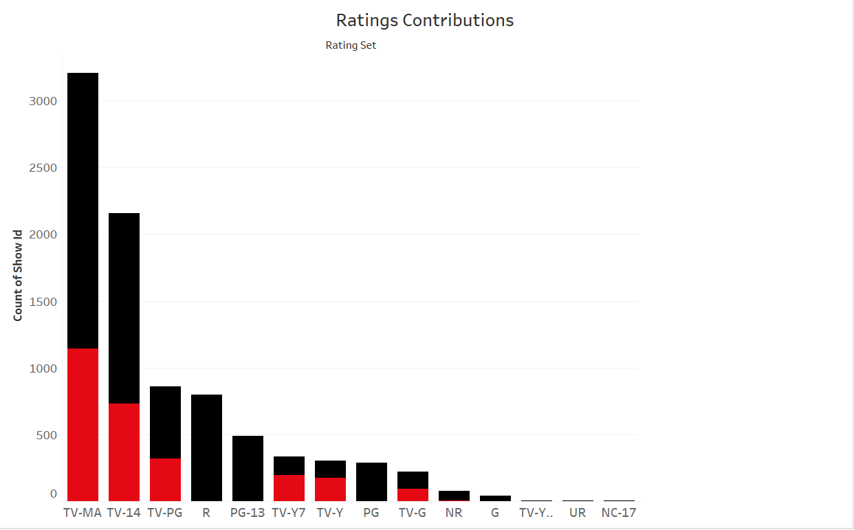
The Types of Rating System?
'Mature Audience only' content is the rating with highest shows count in both TV Shows and Movies.

Slide 10
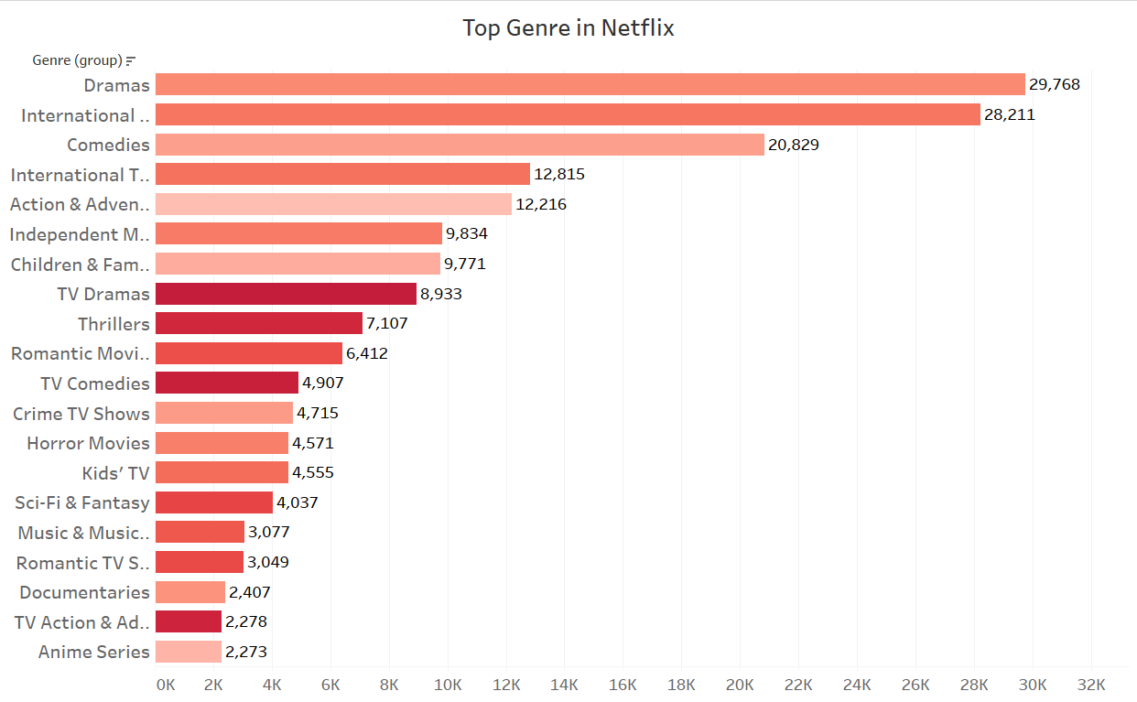
Most Commonly Produced Genres
Dramas and International Movies are the most popular Genres on Netflix

Slide 11
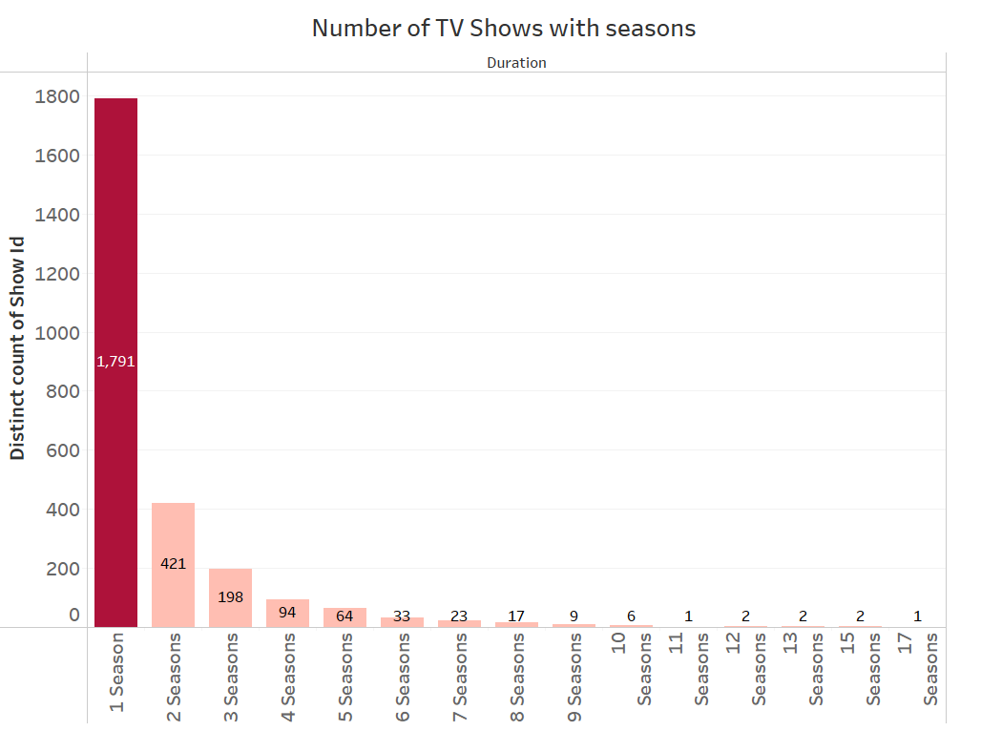
Distribution of the Seasons of the Series
TV shows with less number of season is more popular

Slide 12
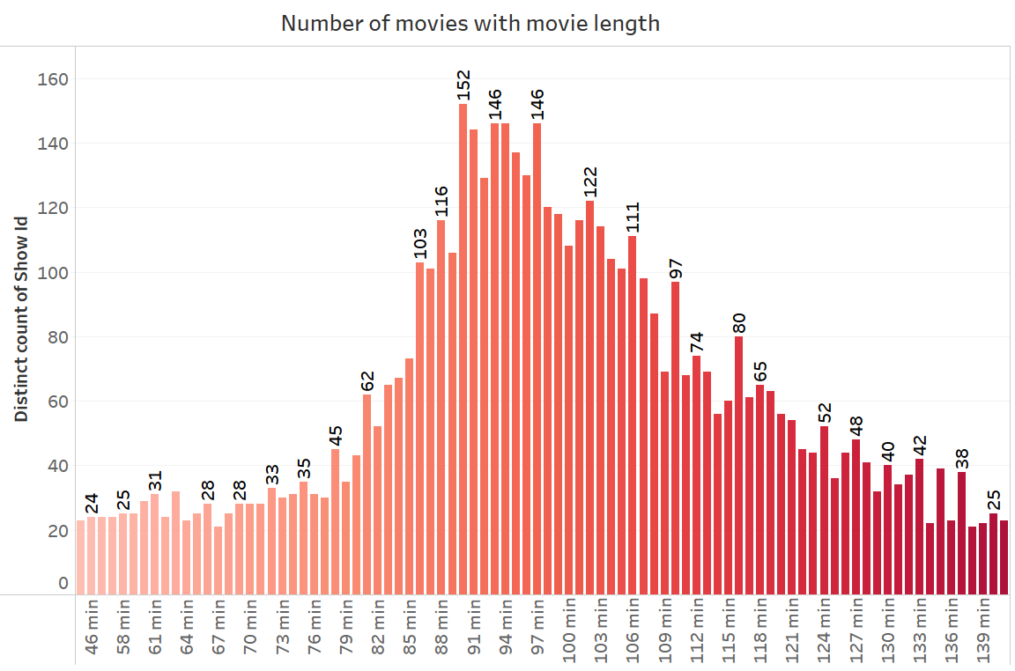
Ideal Duration for Movies
Most of the movies with 80-120mins duration

Slide 13
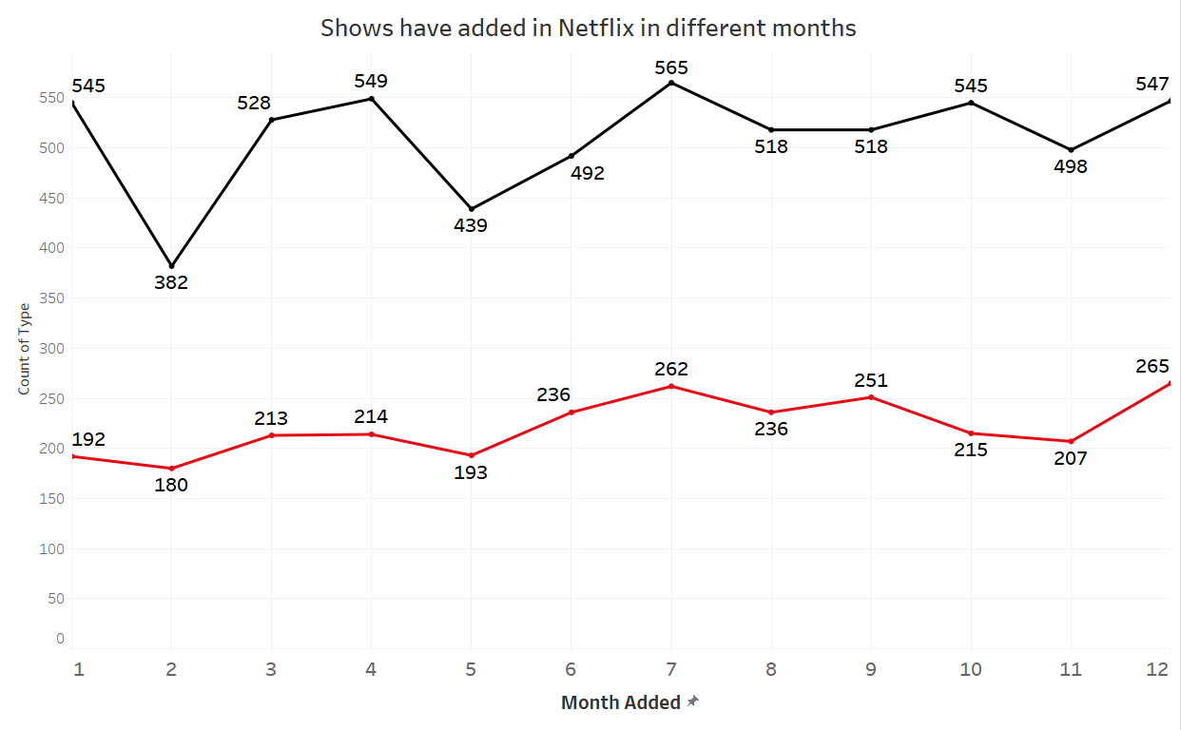
Month with Most and Least Content Added to Netflix
Have less number of Movies and TV Shows added in Netflix in February and most in July.

Slide 14
Business Insights
69.69% of Netflix content in Movies.
From 2018, there's huge depreciation in movies and total shows release but there's trend started for more TV Shows than Movies.
'Mature Audience only' content is the rating with highest shows count in both TV Shows and Movies.
Have less number of Movies and TV Shows added in Netflix in February.
TV shows with less number of season is more popular and Movies with 80-120mins duration.
USA & India has producing more Movies and USA & UK has producing more TV Shows.

Slide 15
Recommendations
Since TV Shows are in trending, we needs to produce more shows in popular Genre.
Has less shows being added to Netflix in February, that's best time to release more shows to have higher probability in more viewers.
TV Shows with less seasons and movies with 80-120mins duration on 'Dramas' & 'Comedies' Genre is preferable.
'Mature Audience only' content is the rating with highest shows count in both TV Shows and Movies. We need to provide more option to attract other age group audience.

Slide 16
Tableau Dashboard Links
Tableau dashboard links for better understand trends, outliers, and patterns in data:-
https://public.tableau.com/app/profile/pratik.patle/viz/NetflixDataAnalysis_16764604243120/Countrywisecontentanalysis
https://public.tableau.com/app/profile/pratik.patle/viz/NetflixDataAnalysisContent/ContentAnalysis

